Slide 1
USA Business Trip June 2012
Torbjörn and Michael
At
Anchor Brewing Co.
San Fransisco
by
Finn Knudsen

Slide 2
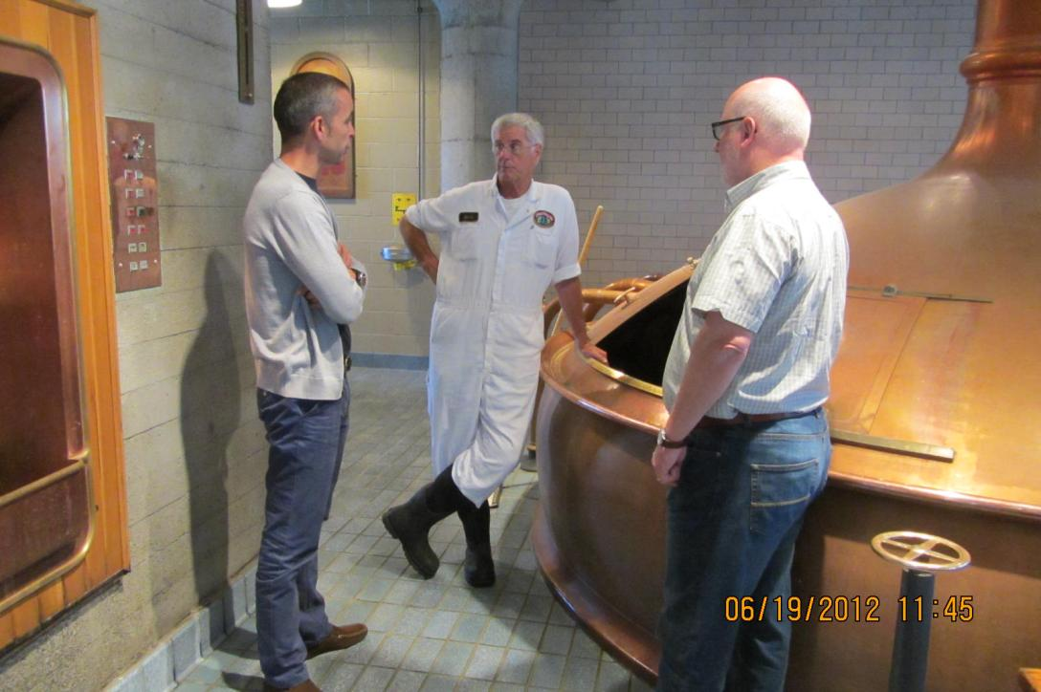
2012-06-19 - Touring Anchor Brewery with Mark Carpenter - Michael og Torbjörn

Slide 3
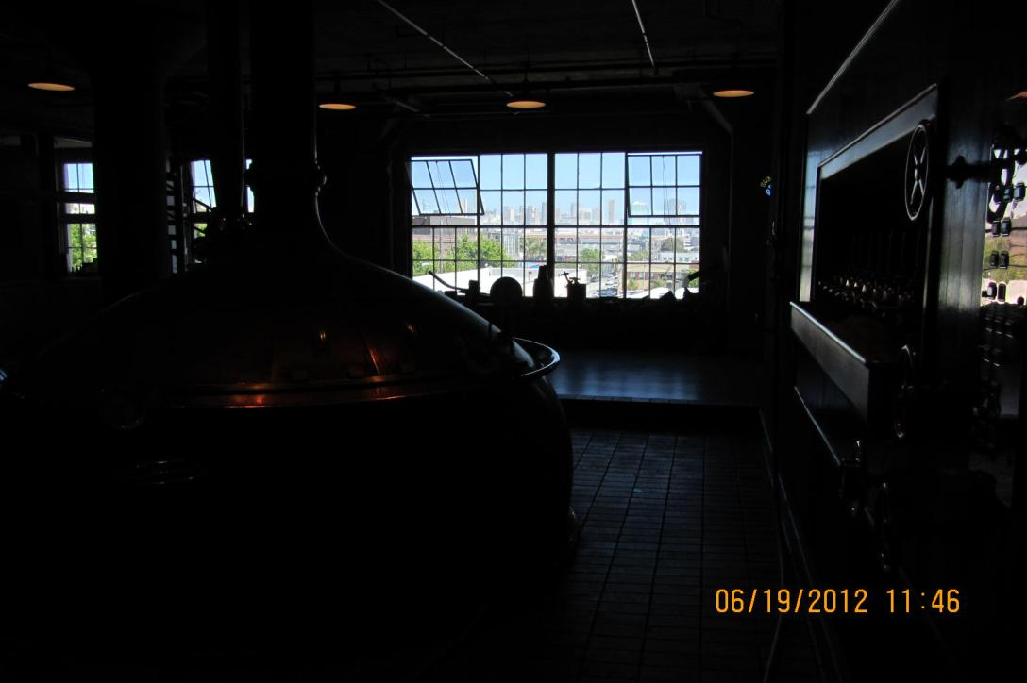
2012-06-19 - Touring Anchor Brewery with Mark Carpenter - Michael og Torbjörn (1)

Slide 4
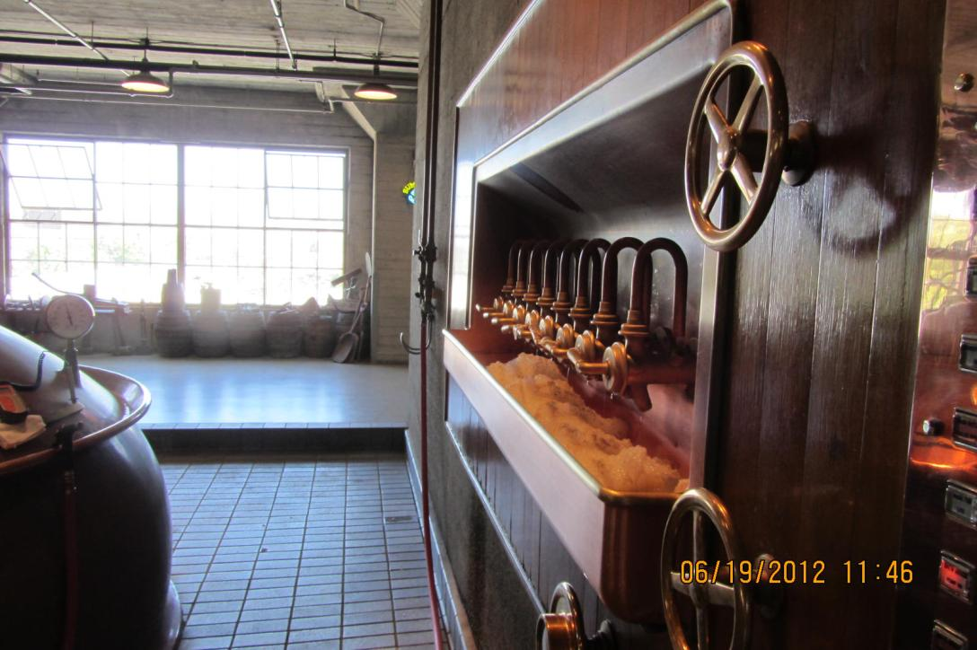
2012-06-19 - Touring Anchor Brewery with Mark Carpenter - Michael og Torbjörn (2)

Slide 5
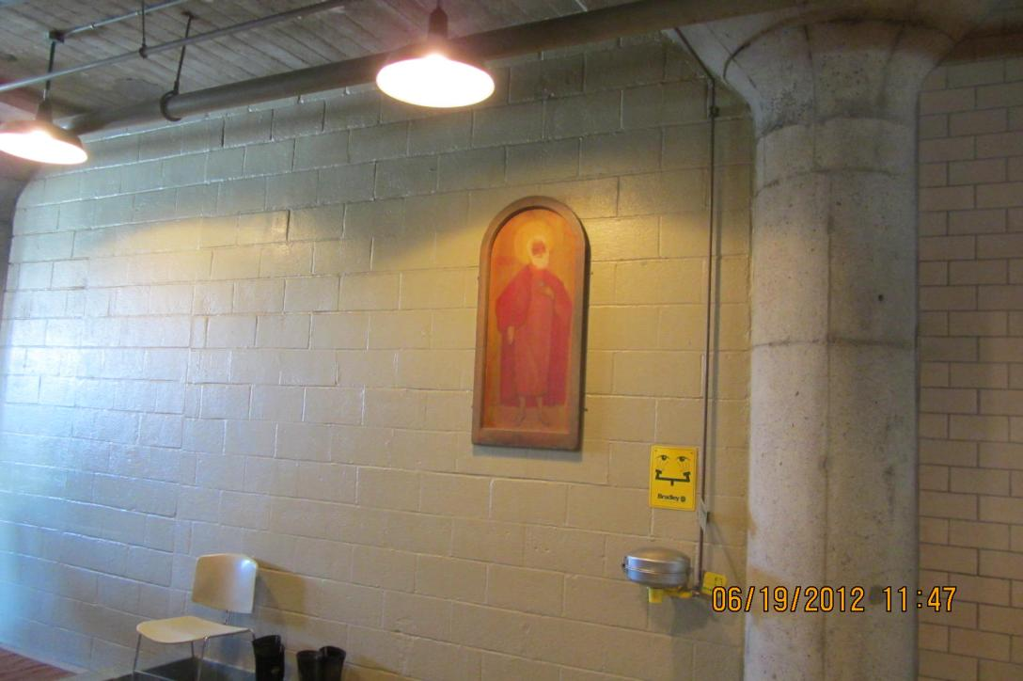
2012-06-19 - Touring Anchor Brewery with Mark Carpenter - Michael og Torbjörn (3)

Slide 6
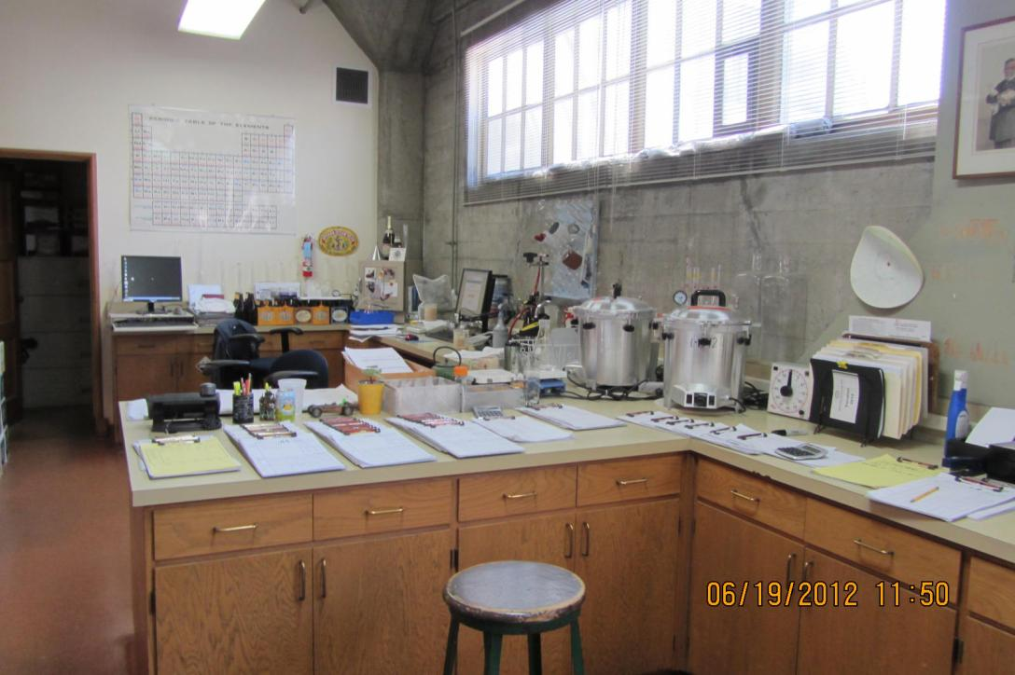
2012-06-19 - Touring Anchor Brewery with Mark Carpenter - Michael og Torbjörn (4)

Slide 7
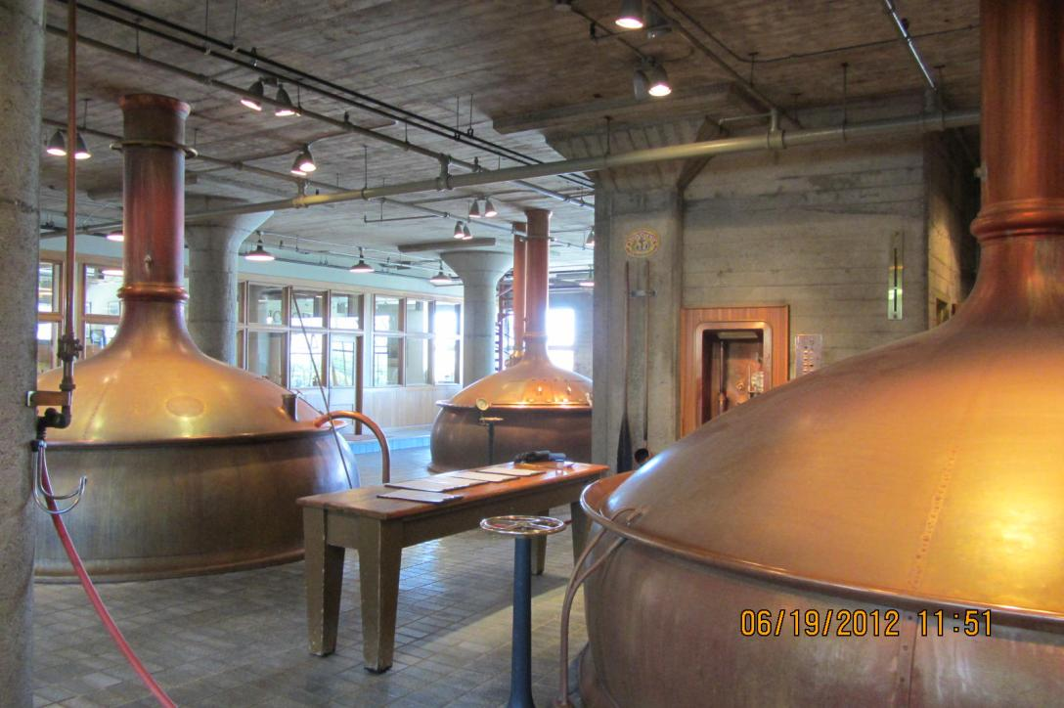
2012-06-19 - Touring Anchor Brewery with Mark Carpenter - Michael og Torbjörn (5)

Slide 8
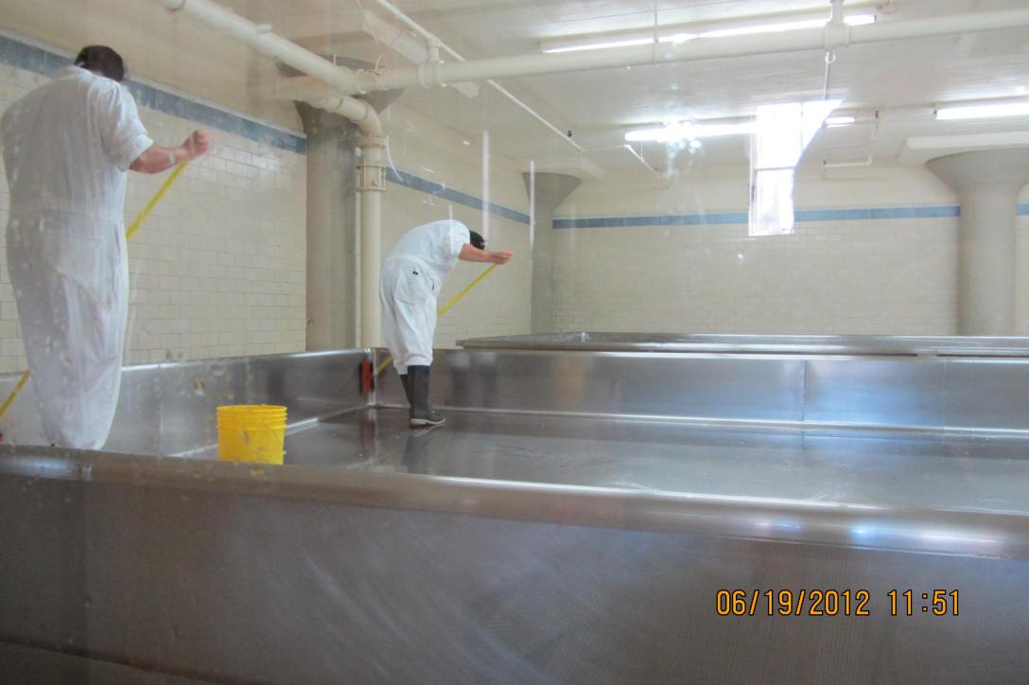
2012-06-19 - Touring Anchor Brewery with Mark Carpenter - Michael og Torbjörn (6)

Slide 9
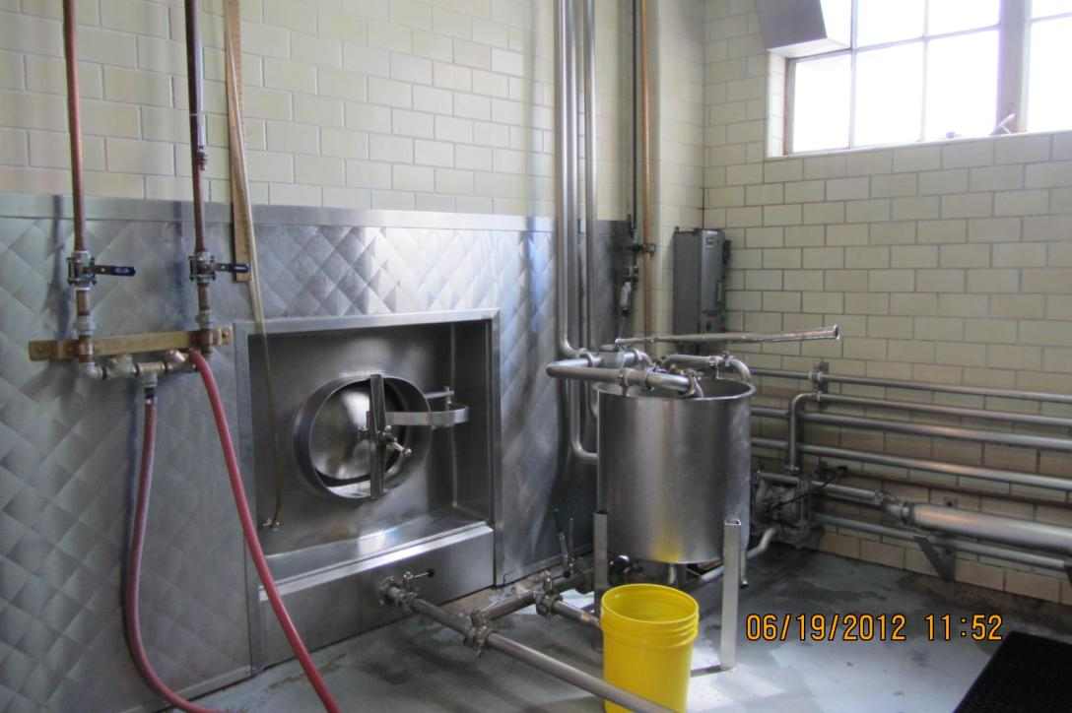
2012-06-19 - Touring Anchor Brewery with Mark Carpenter - Michael og Torbjörn (7)

Slide 10
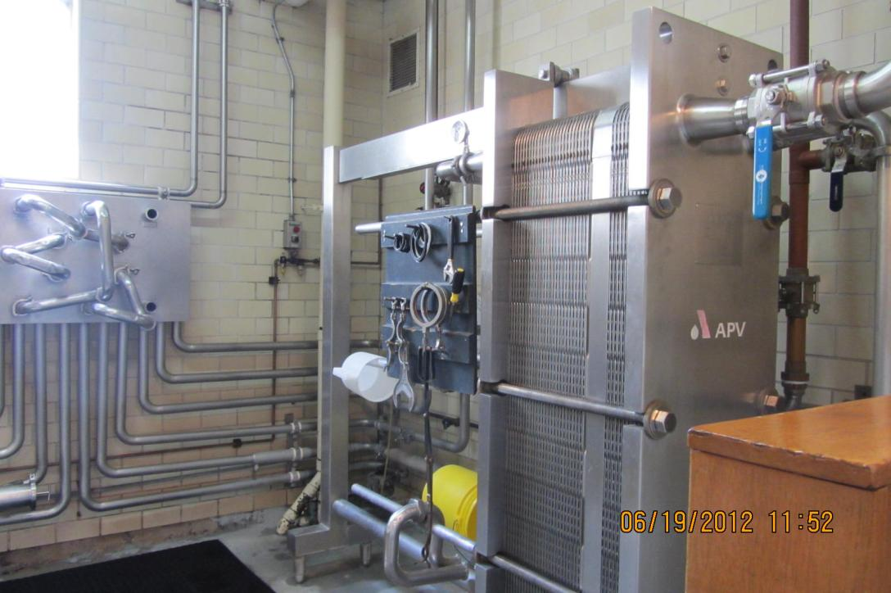
2012-06-19 - Touring Anchor Brewery with Mark Carpenter - Michael og Torbjörn (8)

Slide 11
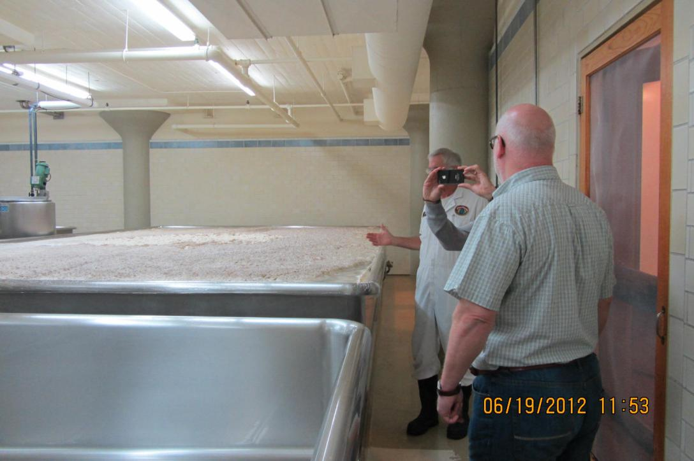
2012-06-19 - Touring Anchor Brewery with Mark Carpenter - Michael og Torbjörn (9)

Slide 12
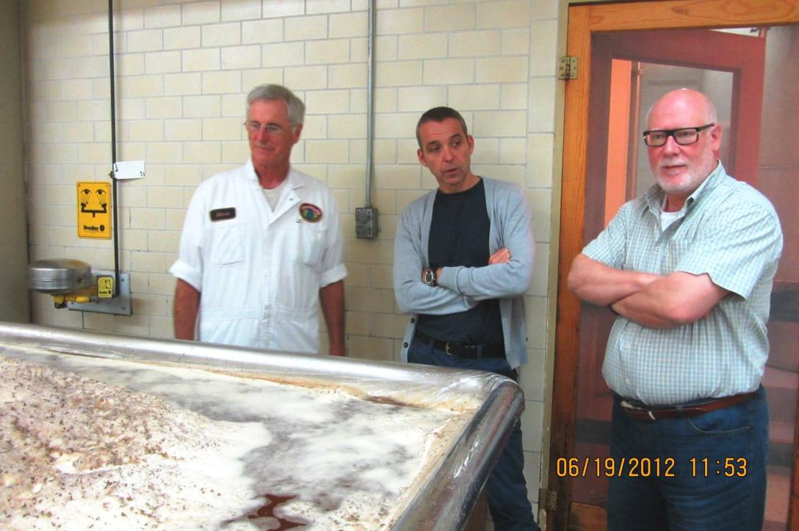
2012-06-19 - Touring Anchor Brewery with Mark Carpenter - Michael og Torbjörn (10)

Slide 13
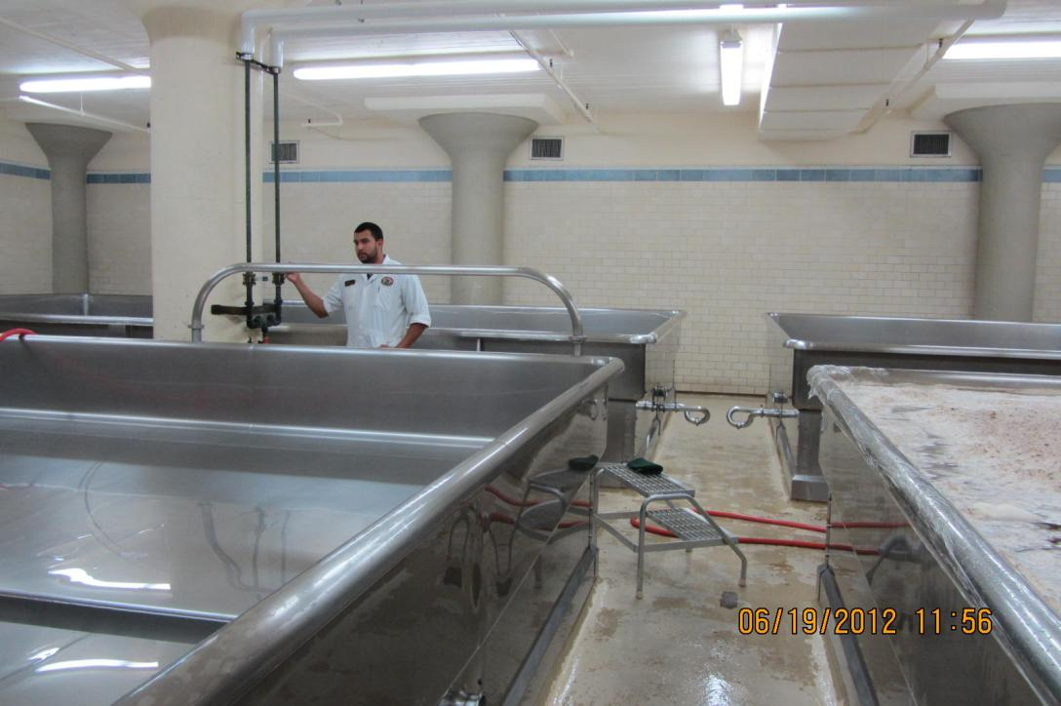
2012-06-19 - Touring Anchor Brewery with Mark Carpenter - Michael og Torbjörn (11)

Slide 14
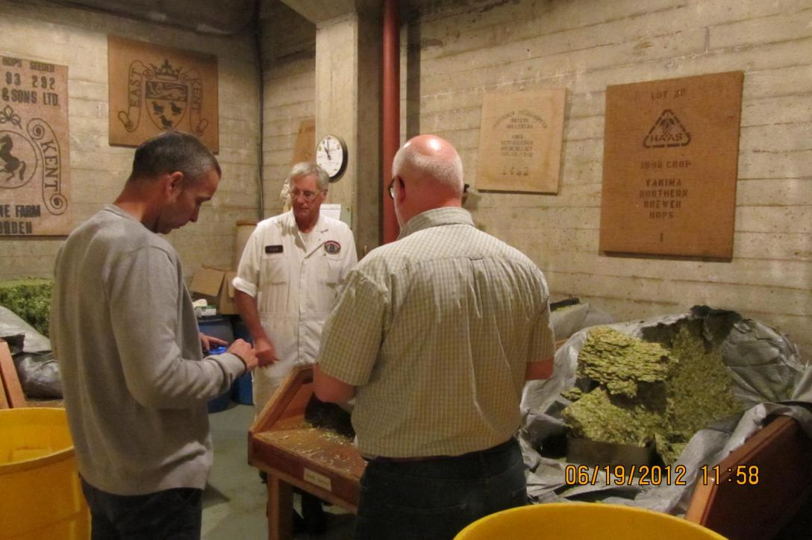
2012-06-19 - Touring Anchor Brewery with Mark Carpenter - Michael og Torbjörn (12)

Slide 15
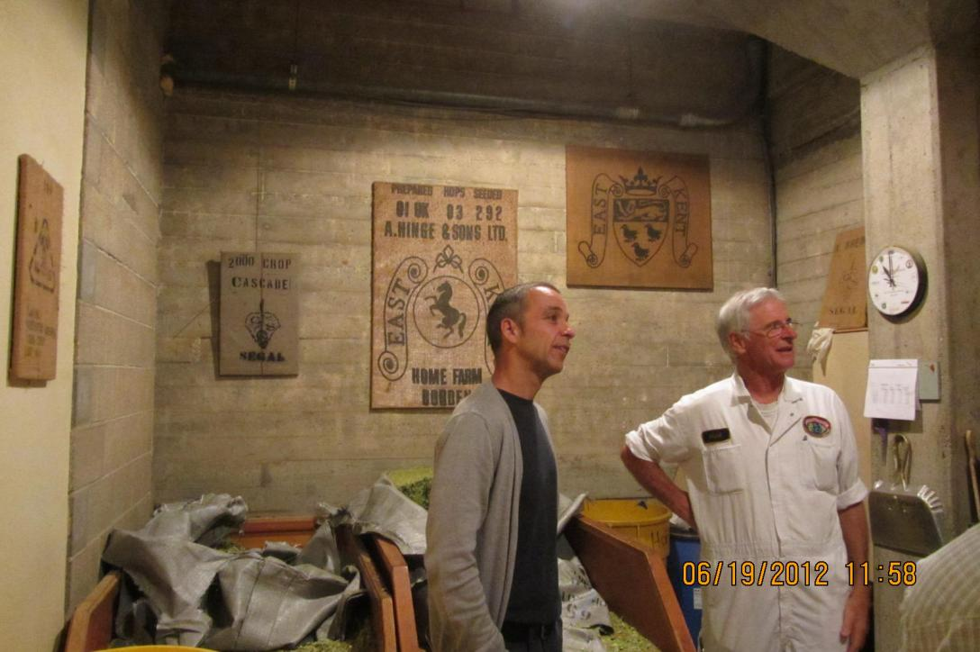
2012-06-19 - Touring Anchor Brewery with Mark Carpenter - Michael og Torbjörn (13)

Slide 16
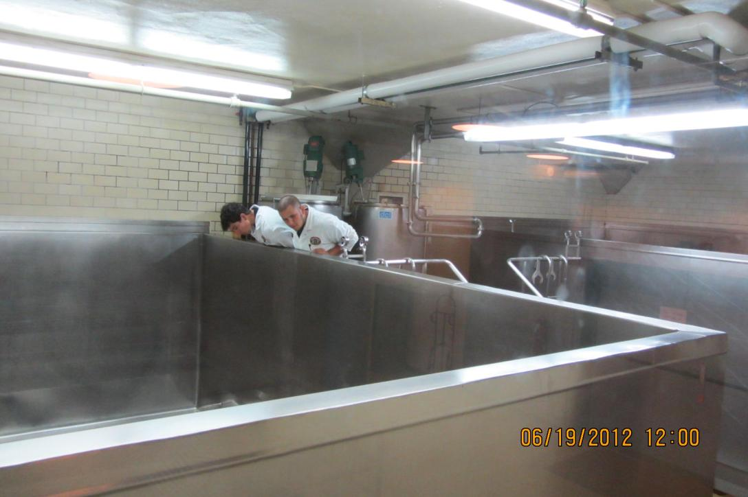
2012-06-19 - Touring Anchor Brewery with Mark Carpenter - Michael og Torbjörn (14)

Slide 17
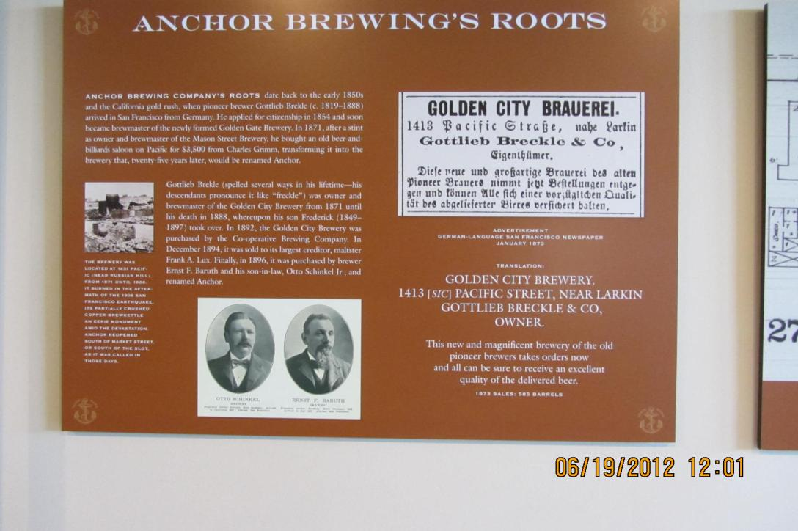
2012-06-19 - Touring Anchor Brewery with Mark Carpenter - Michael og Torbjörn (15)

Slide 18
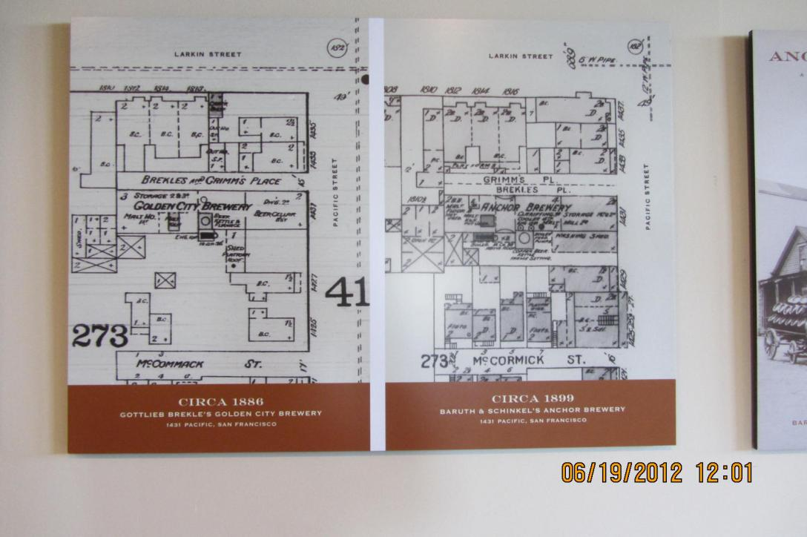
2012-06-19 - Touring Anchor Brewery with Mark Carpenter - Michael og Torbjörn (16)

Slide 19
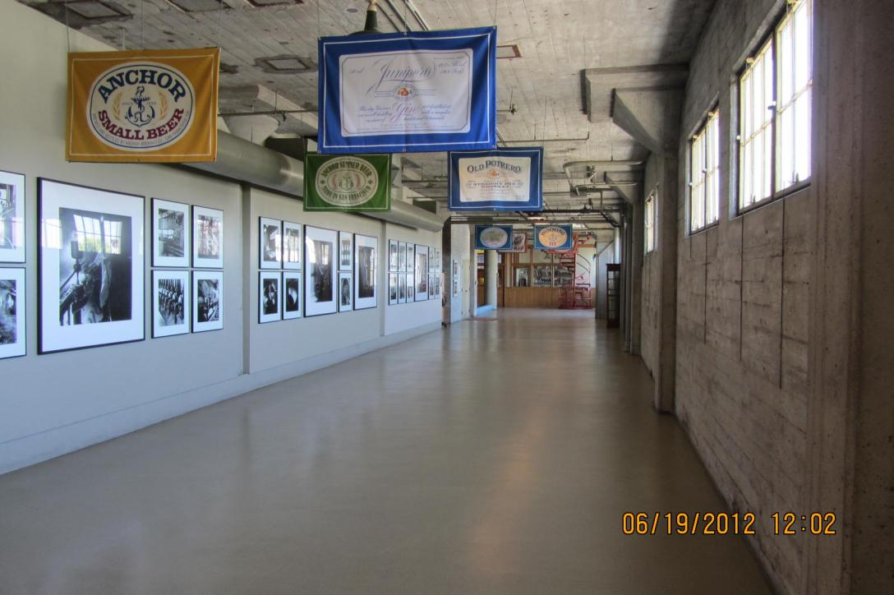
2012-06-19 - Touring Anchor Brewery with Mark Carpenter - Michael og Torbjörn (17)

Slide 20
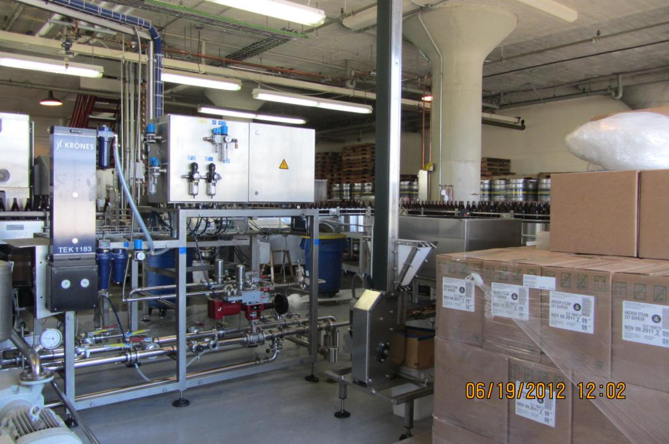
2012-06-19 - Touring Anchor Brewery with Mark Carpenter - Michael og Torbjörn (18)

Slide 21
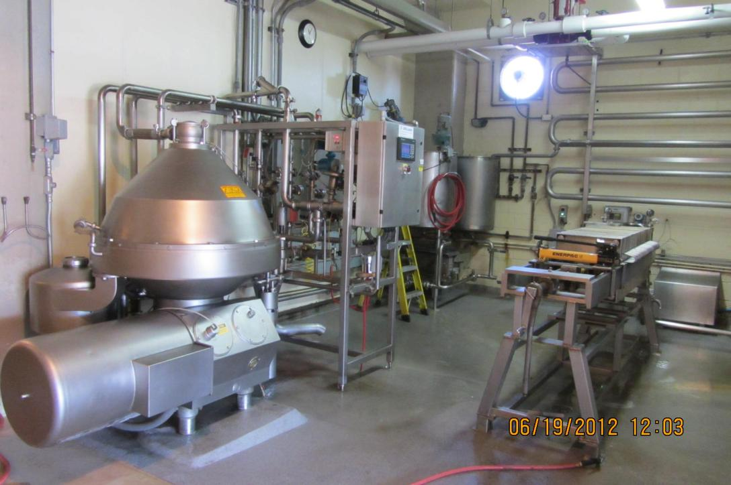
2012-06-19 - Touring Anchor Brewery with Mark Carpenter - Michael og Torbjörn (19)

Slide 22
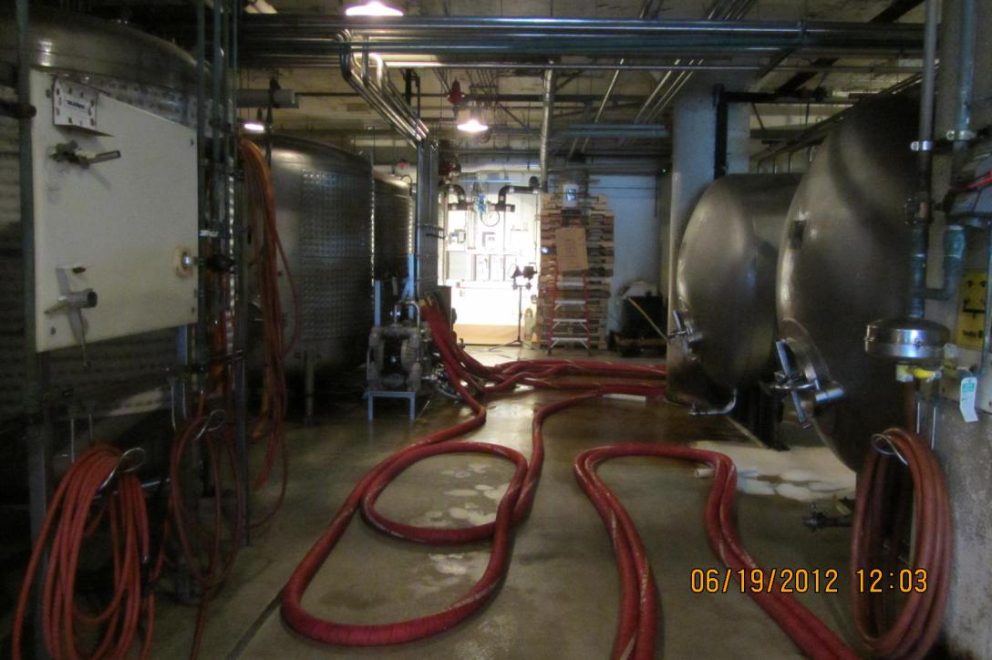
2012-06-19 - Touring Anchor Brewery with Mark Carpenter - Michael og Torbjörn (20)

Slide 23
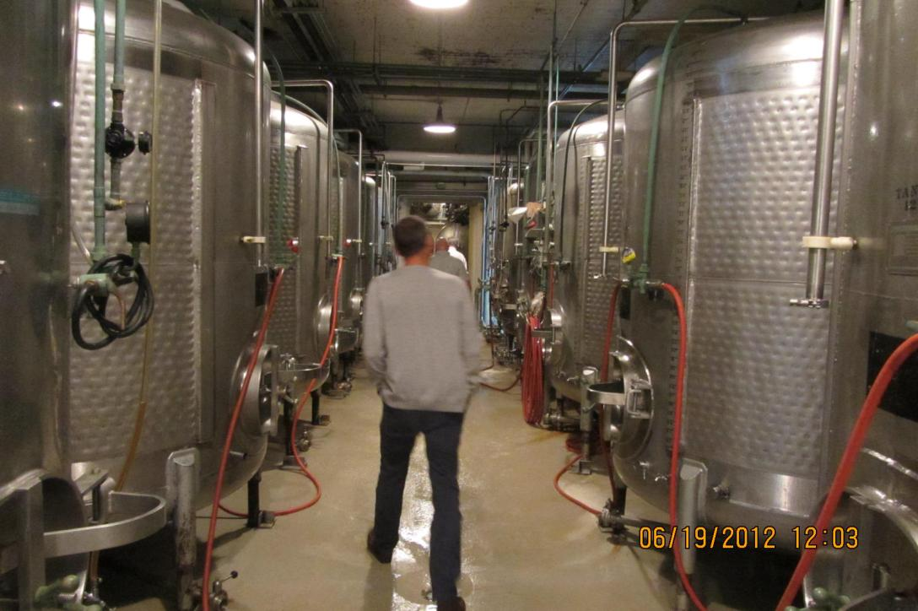
2012-06-19 - Touring Anchor Brewery with Mark Carpenter - Michael og Torbjörn (21)

Slide 24
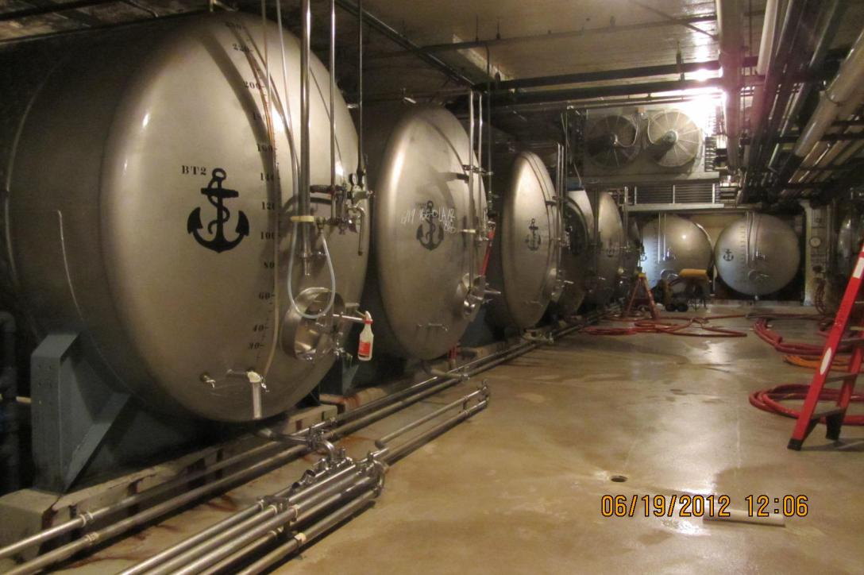
2012-06-19 - Touring Anchor Brewery with Mark Carpenter - Michael og Torbjörn (22)

Slide 25
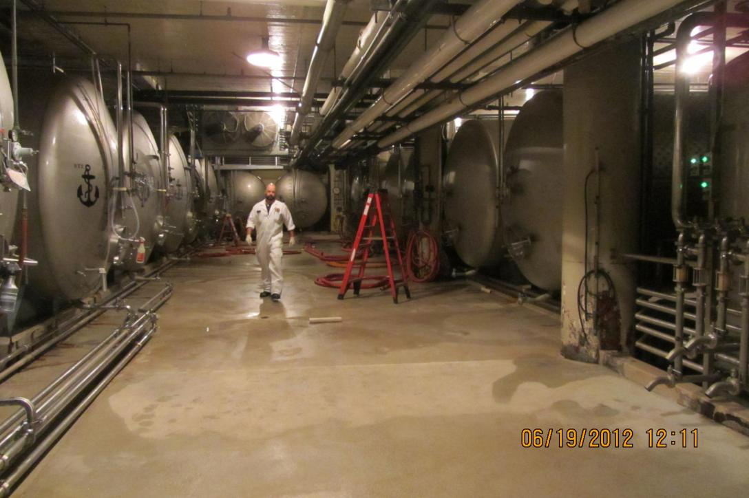
2012-06-19 - Touring Anchor Brewery with Mark Carpenter - Michael og Torbjörn (23)

Slide 26
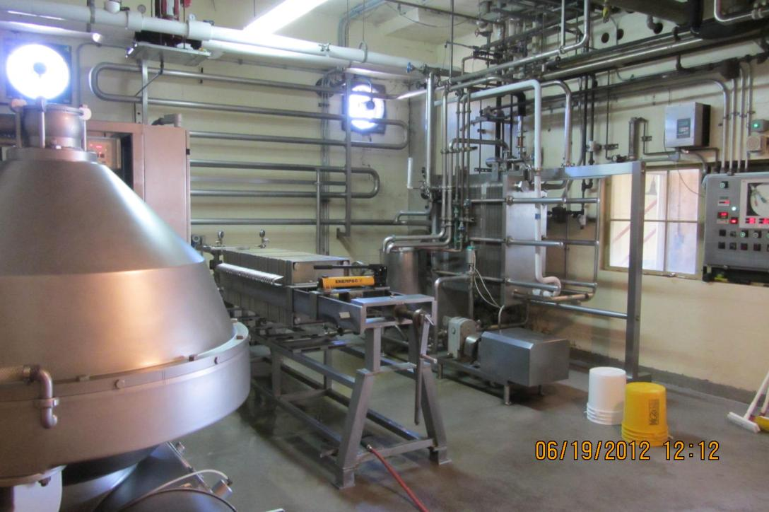
2012-06-19 - Touring Anchor Brewery with Mark Carpenter - Michael og Torbjörn (24)

Slide 27
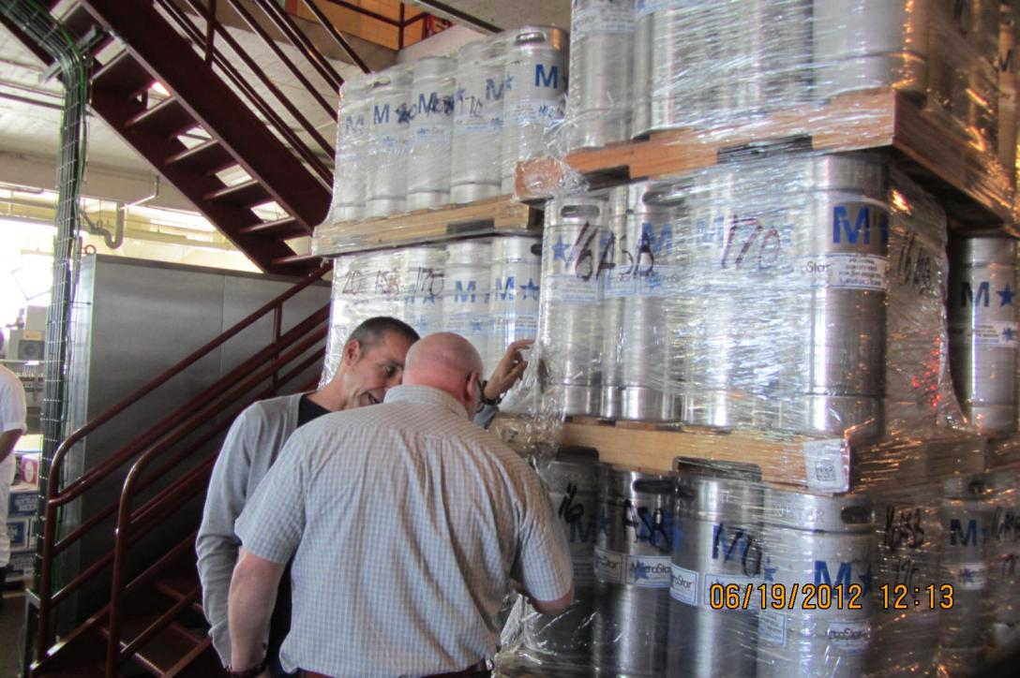
2012-06-19 - Touring Anchor Brewery with Mark Carpenter - Michael og Torbjörn (25)

Slide 28
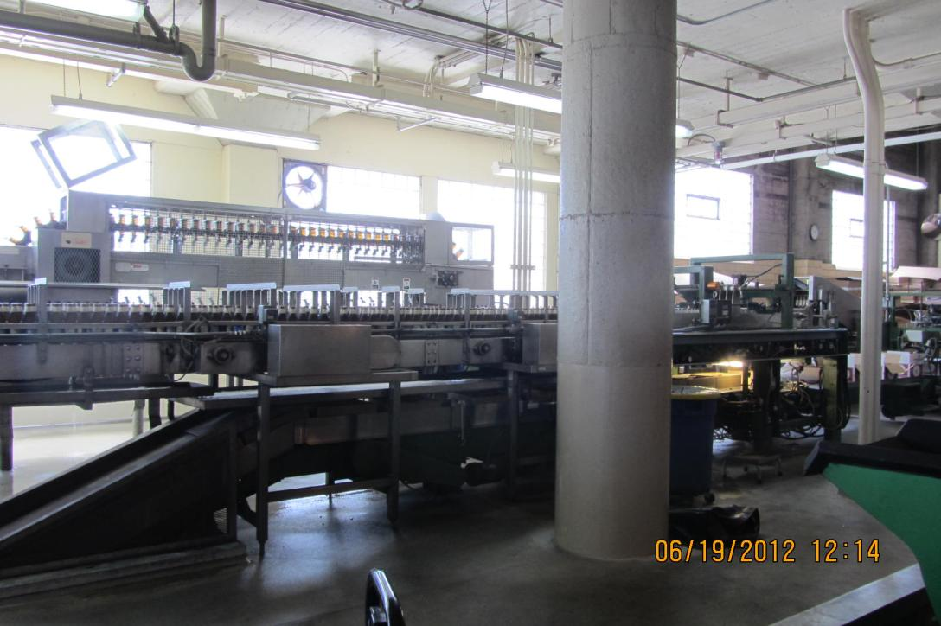
2012-06-19 - Touring Anchor Brewery with Mark Carpenter - Michael og Torbjörn (26)

Slide 29
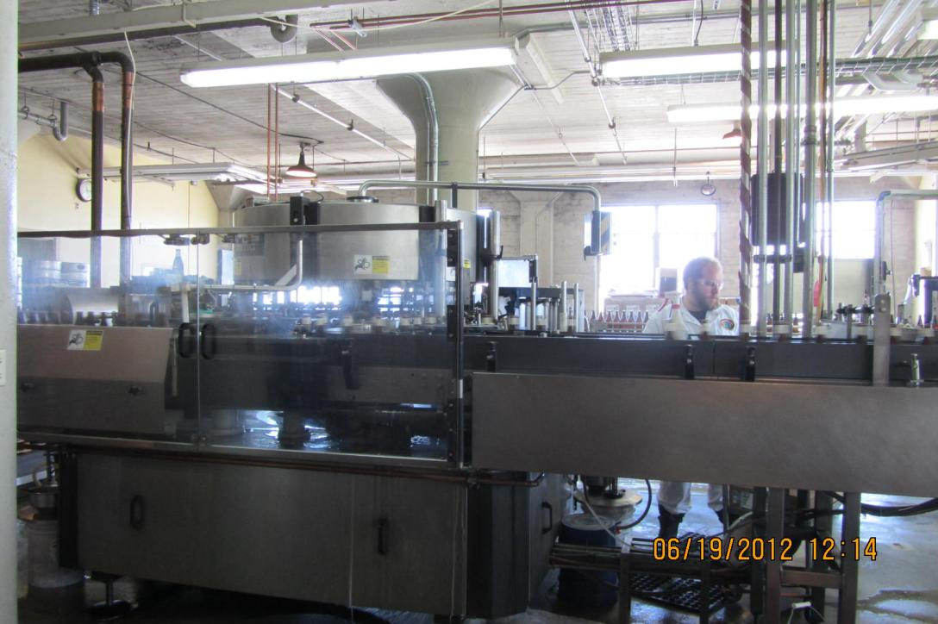
2012-06-19 - Touring Anchor Brewery with Mark Carpenter - Michael og Torbjörn (27)

Slide 30
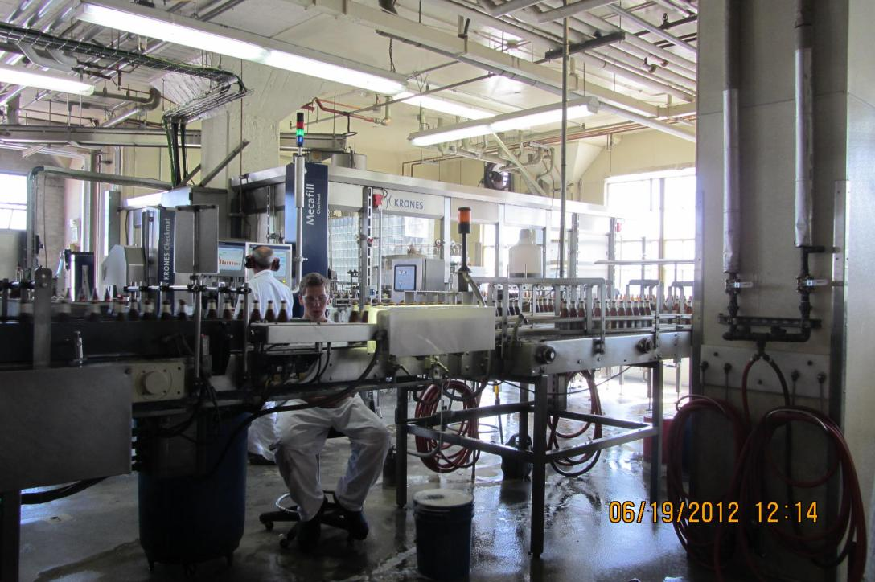
2012-06-19 - Touring Anchor Brewery with Mark Carpenter - Michael og Torbjörn (28)

Slide 31
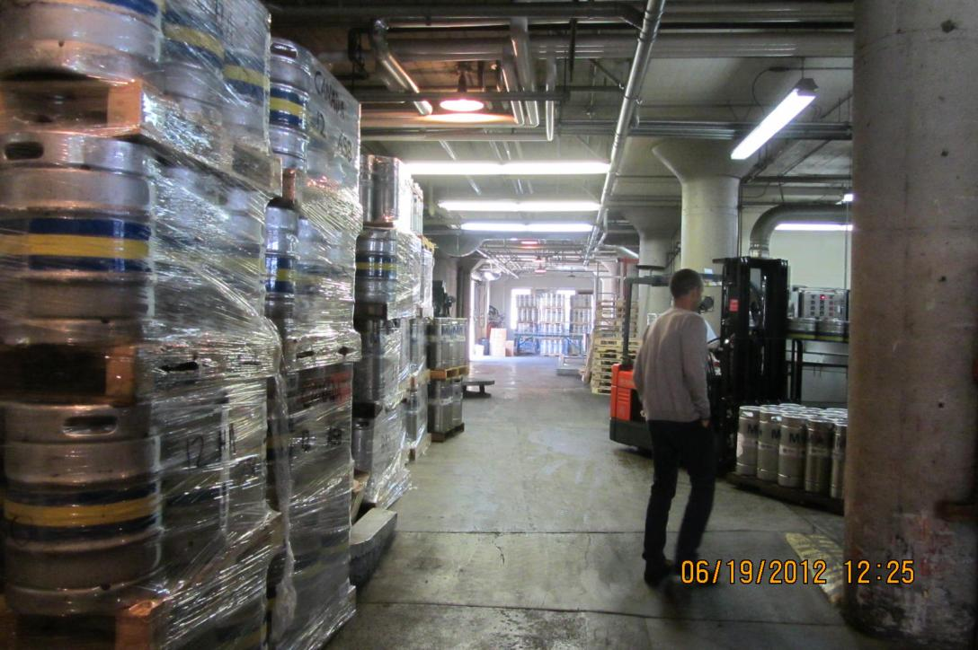
2012-06-19 - Touring Anchor Brewery with Mark Carpenter - Michael og Torbjörn (29)

Slide 32
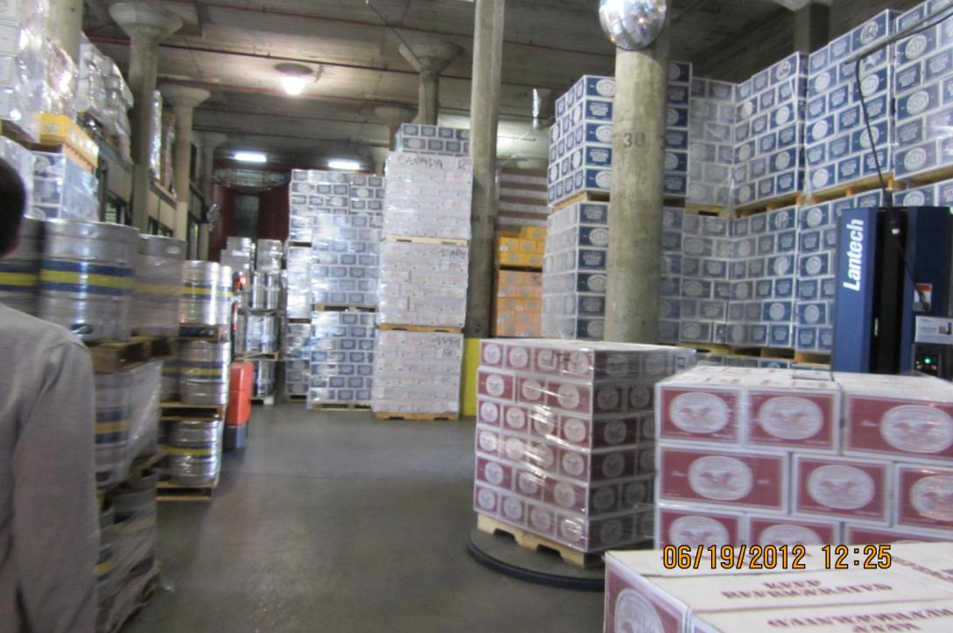
2012-06-19 - Touring Anchor Brewery with Mark Carpenter - Michael og Torbjörn (30)

Slide 33
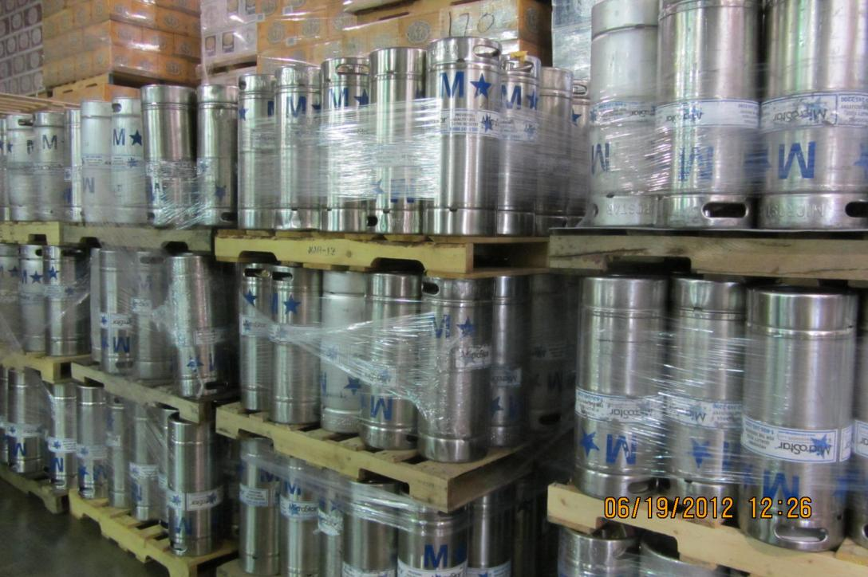
2012-06-19 - Touring Anchor Brewery with Mark Carpenter - Michael og Torbjörn (31)

Slide 34
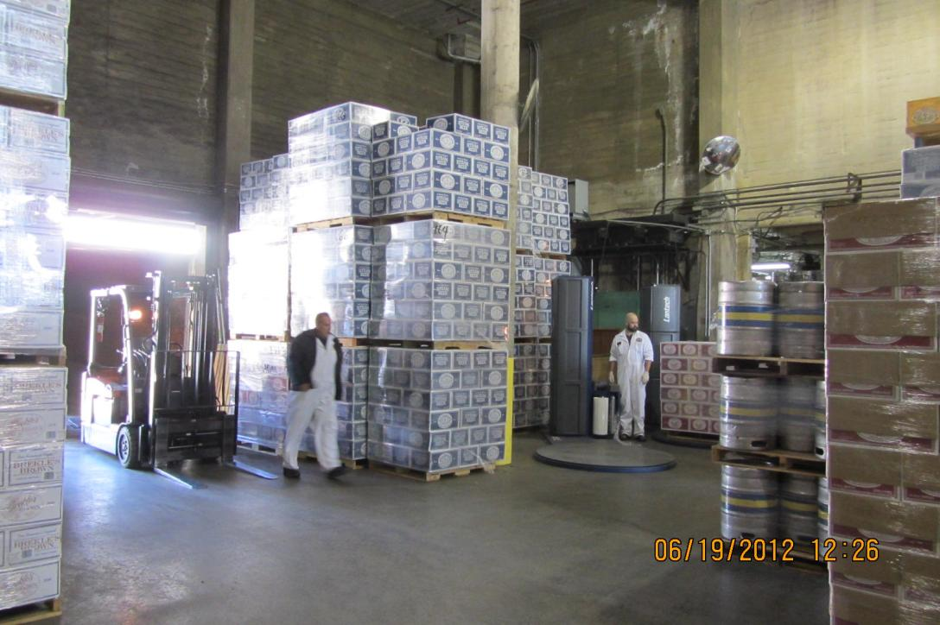
2012-06-19 - Touring Anchor Brewery with Mark Carpenter - Michael og Torbjörn (32)

Slide 35
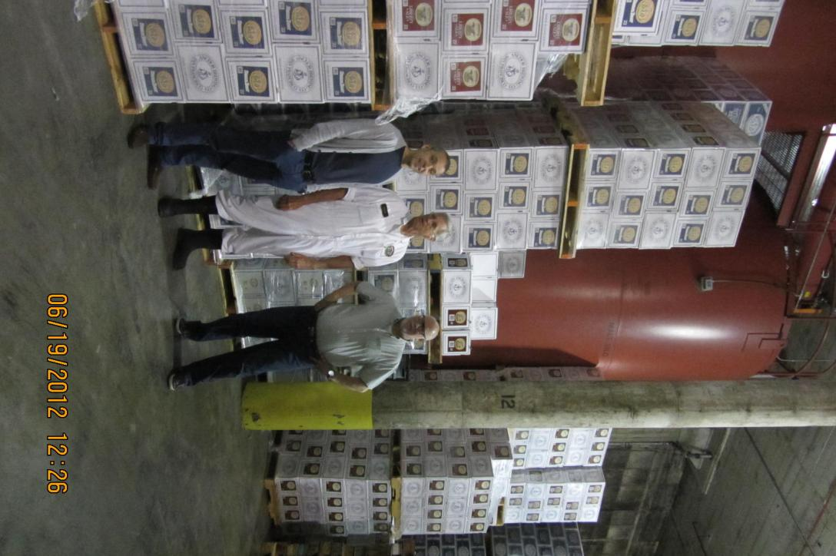
2012-06-19 - Touring Anchor Brewery with Mark Carpenter - Michael og Torbjörn (33)

Slide 36
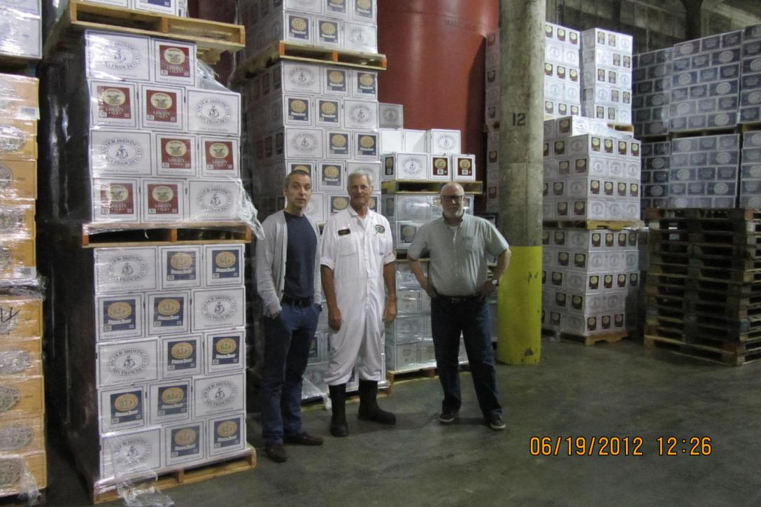
2012-06-19 - Touring Anchor Brewery with Mark Carpenter - Michael og Torbjörn (34)

Slide 37
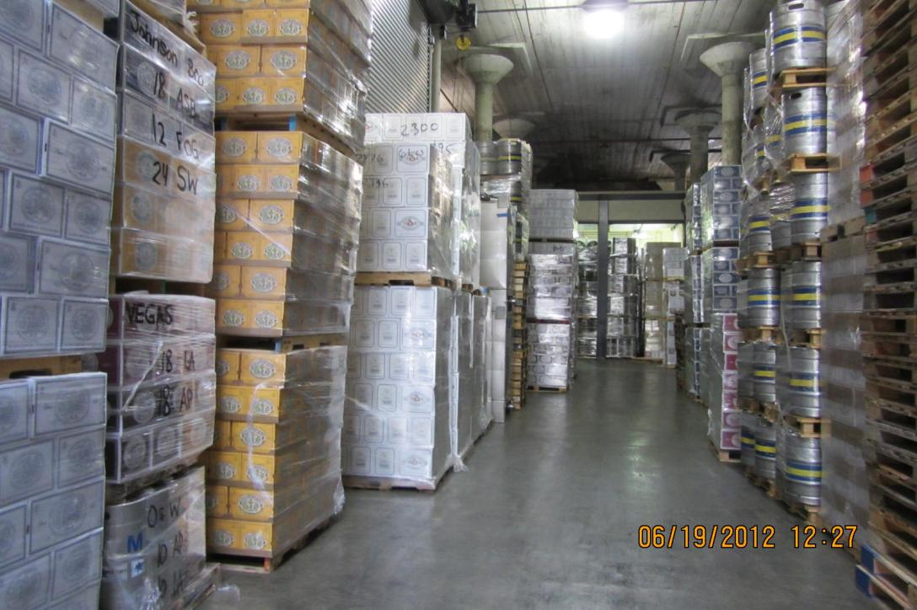
2012-06-19 - Touring Anchor Brewery with Mark Carpenter - Michael og Torbjörn (35)

Slide 38
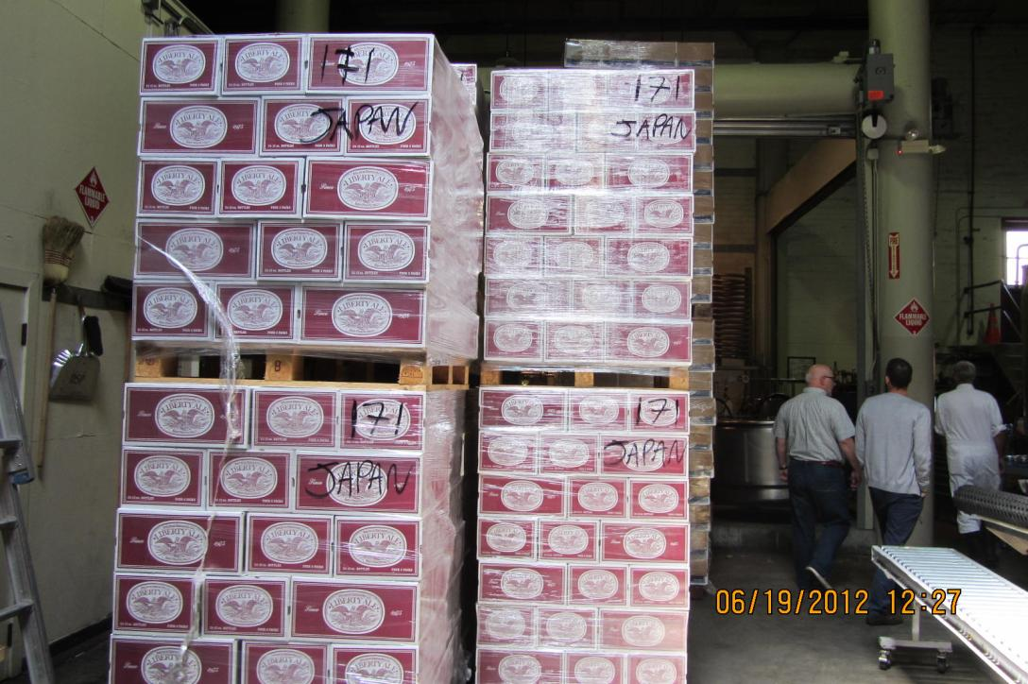
2012-06-19 - Touring Anchor Brewery with Mark Carpenter - Michael og Torbjörn (36)

Slide 39
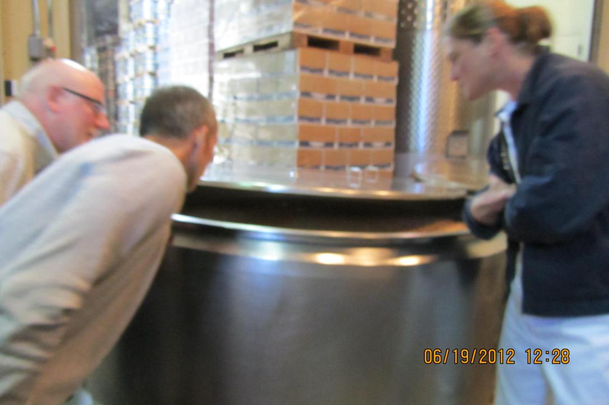
2012-06-19 - Touring Anchor Brewery with Mark Carpenter - Michael og Torbjörn (37)

Slide 40
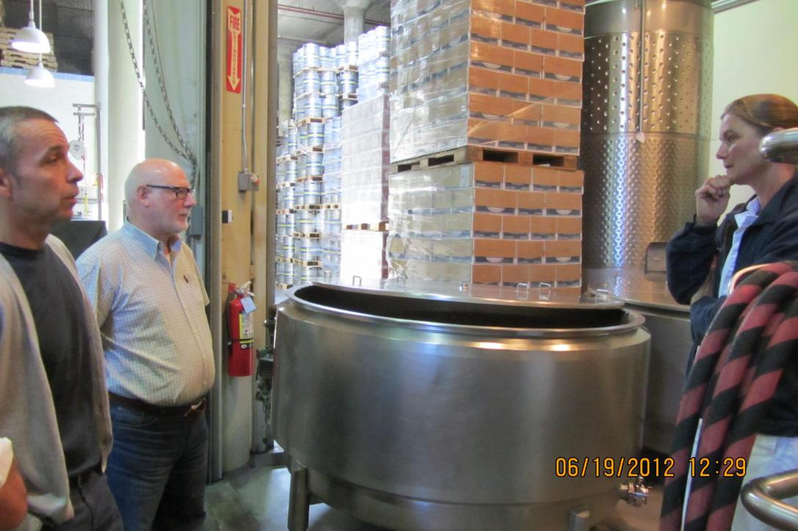
2012-06-19 - Touring Anchor Brewery with Mark Carpenter - Michael og Torbjörn (38)

Slide 41
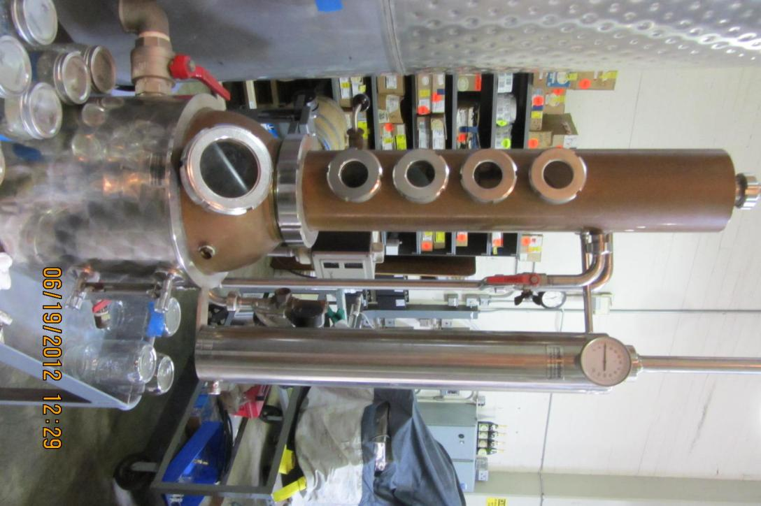
2012-06-19 - Touring Anchor Brewery with Mark Carpenter - Michael og Torbjörn (39)

Slide 42
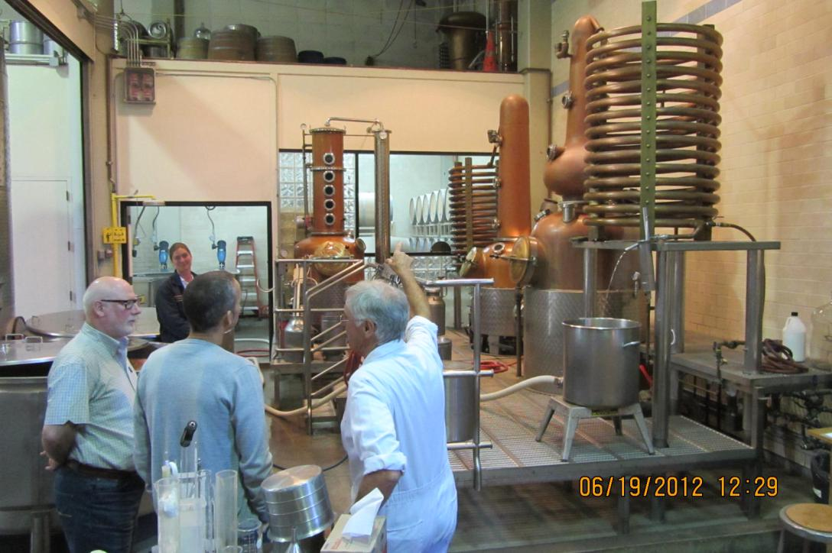
2012-06-19 - Touring Anchor Brewery with Mark Carpenter - Michael og Torbjörn (40)

Slide 43
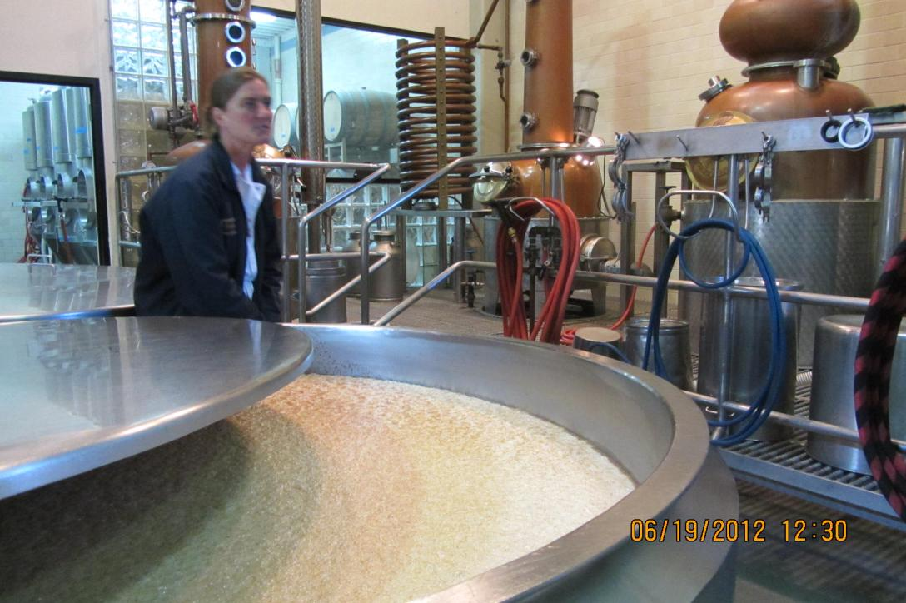
2012-06-19 - Touring Anchor Brewery with Mark Carpenter - Michael og Torbjörn (41)

Slide 44
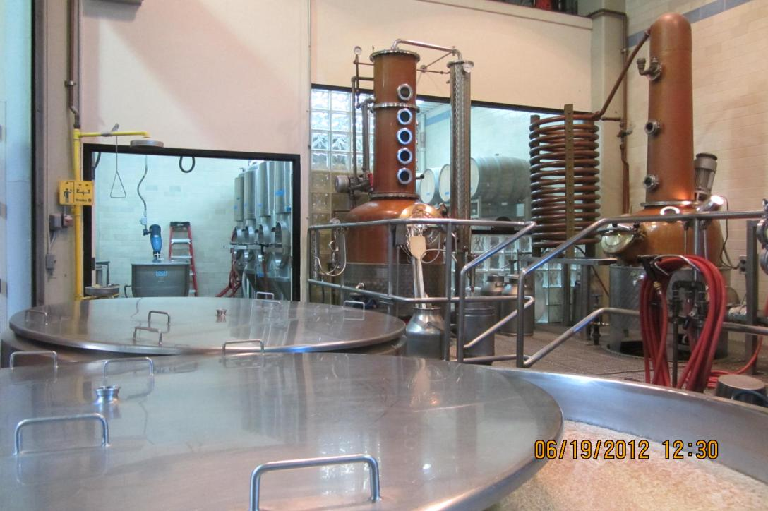
2012-06-19 - Touring Anchor Brewery with Mark Carpenter - Michael og Torbjörn (42)

Slide 45
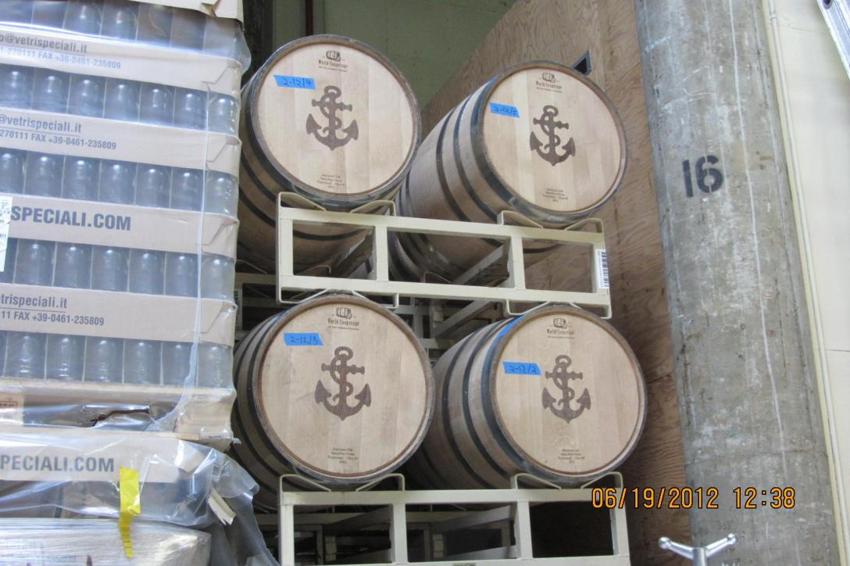
2012-06-19 - Touring Anchor Brewery with Mark Carpenter - Michael og Torbjörn (43)

Slide 46
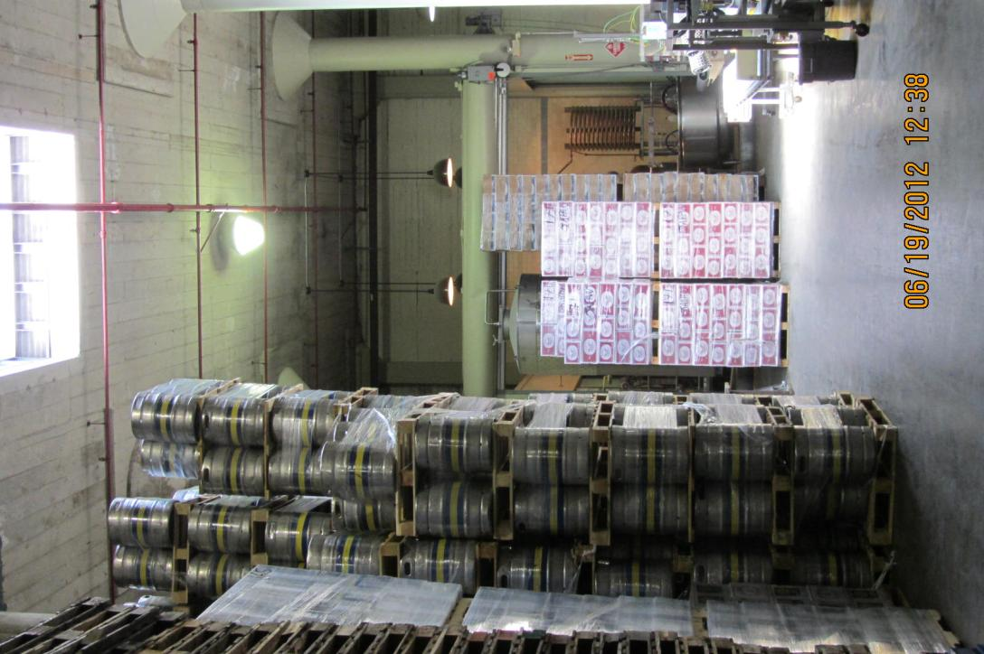
2012-06-19 - Touring Anchor Brewery with Mark Carpenter - Michael og Torbjörn (44)

Slide 47
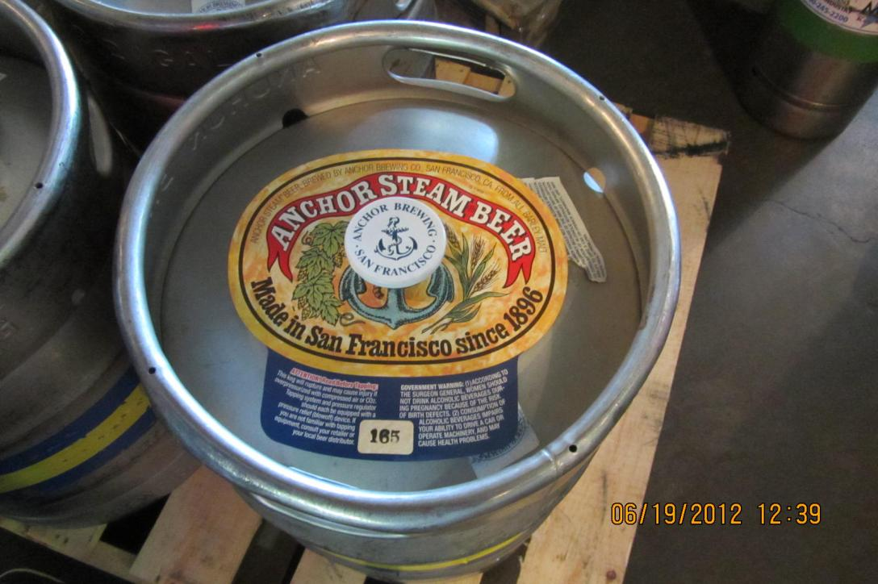
2012-06-19 - Touring Anchor Brewery with Mark Carpenter - Michael og Torbjörn (45)

Slide 48
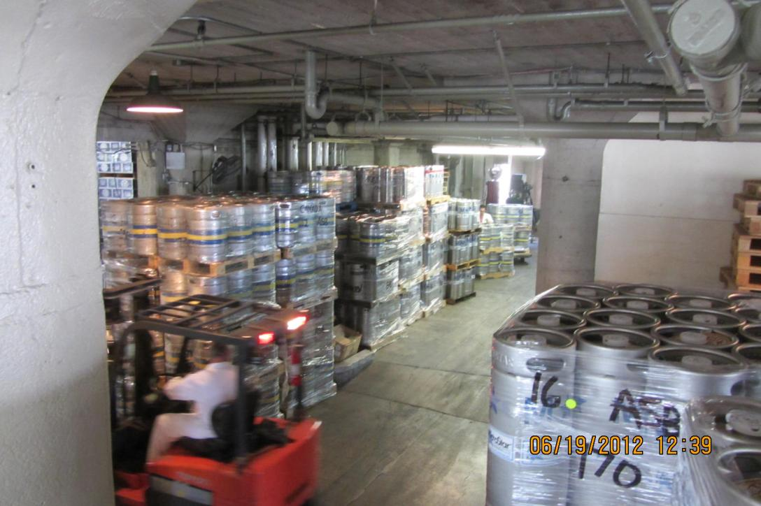
2012-06-19 - Touring Anchor Brewery with Mark Carpenter - Michael og Torbjörn (46)

Slide 49
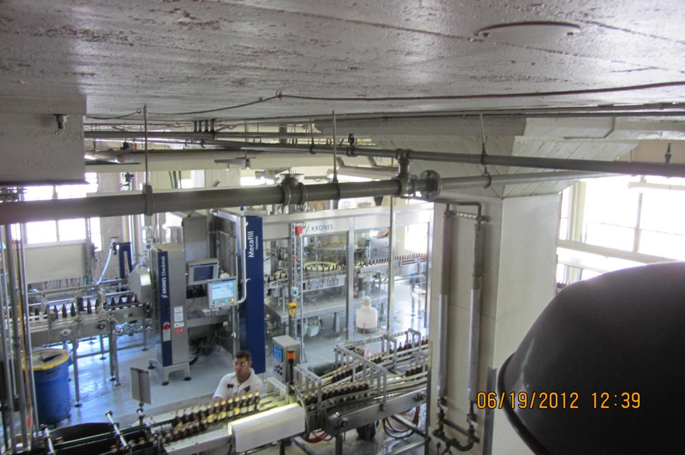
2012-06-19 - Touring Anchor Brewery with Mark Carpenter - Michael og Torbjörn (47)

Slide 50
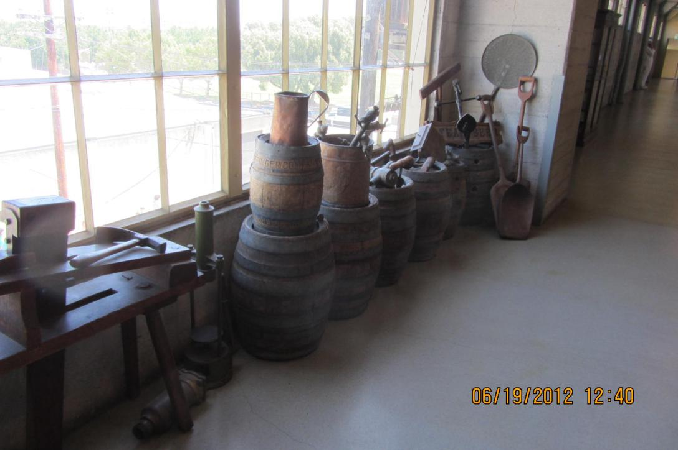
2012-06-19 - Touring Anchor Brewery with Mark Carpenter - Michael og Torbjörn (48)

Slide 51
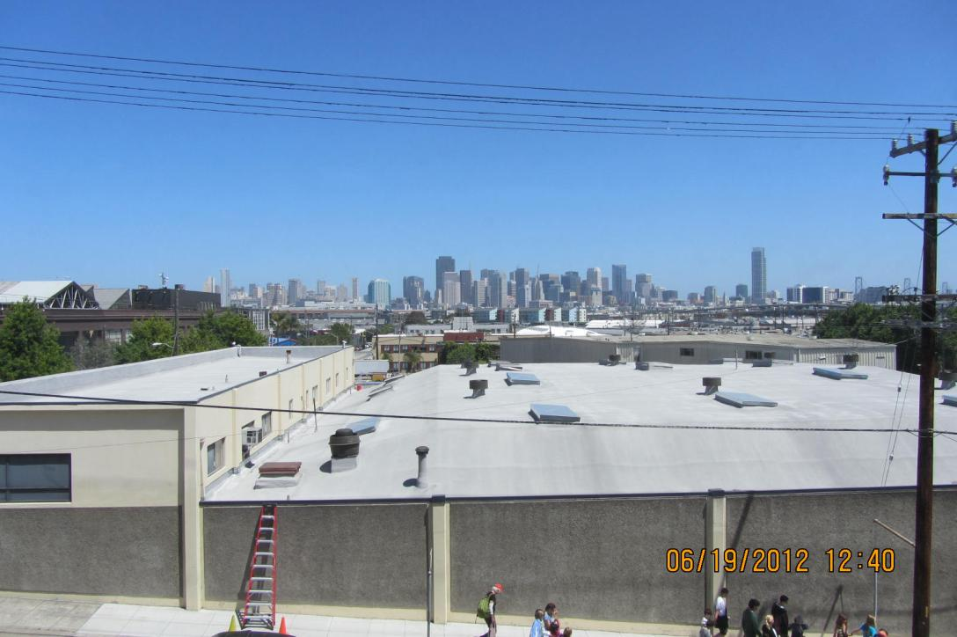
2012-06-19 - Touring Anchor Brewery with Mark Carpenter - Michael og Torbjörn (49)

Slide 52

2012-06-19 - Touring Anchor Brewery with Mark Carpenter - Michael og Torbjörn (50)

Slide 53

2012-06-19 - Touring Anchor Brewery with Mark Carpenter - Michael og Torbjörn (51)

Slide 54

2012-06-19 - Touring Anchor Brewery with Mark Carpenter - Michael og Torbjörn (52)

Slide 55

2012-06-19 - Touring Anchor Brewery with Mark Carpenter - Michael og Torbjörn (53)

Slide 56

2012-06-19 - Touring Anchor Brewery with Mark Carpenter - Michael og Torbjörn (54)

Slide 57

2012-06-19 - Touring Anchor Brewery with Mark Carpenter - Michael og Torbjörn (55)

Slide 58

2012-06-19 - Touring Anchor Brewery with Mark Carpenter - Michael og Torbjörn (56)

Slide 59

2012-06-19 - Touring Anchor Brewery with Mark Carpenter - Michael og Torbjörn (57)

Slide 60

2012-06-19 - Touring Anchor Brewery with Mark Carpenter - Michael og Torbjörn (58)

Slide 61

2012-06-19 - Touring Anchor Brewery with Mark Carpenter - Michael og Torbjörn (59)

Slide 62

2012-06-19 - Touring Anchor Brewery with Mark Carpenter - Michael og Torbjörn (60)

